Slide 1
Mitron Bank New Credit Card Line Strategy
By Suraj Mane

Slide 2
Problem Statement
Mitron Bank is a legacy financial institution headquartered in Hyderabad. They want to introduce a new line of credit cards, aiming to broaden its product offerings and reach in the financial market
AtliQ Data Services came to know about this through an internal link and approached Mitron Bank with a proposal to implement this project. However, strategy director of Mitron Bank, Mr.Bashnir Rover is skeptical and asked them to do a pilot project with the sample data before handing them the full project. They provided a sample dataset of 4000 customers across five cities on their online spend and other details.
Provided data is divided into two different datasets
1. dim_customers
2. Fact_Spends

Slide 3
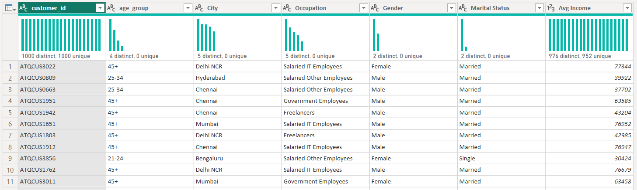
Data Layout
Column Description for dim_customers:
customer_id: This column represents the Unique ID assigned to each customer.
gender: This column represents the gender of the customer. (Male, Female)
age_group: This column categorizes the customer into different age groups. (21-24, 25-34, 35-45, 45+)
marital_status: This column indicates the marital status of the customer (single, married).
city: This column represents the city of residence for the customer. (Mumbai, Delhi-NCR, Chennai, Hyderabad, Bengaluru)
occupation: This column denotes the occupation or profession of the customer. (Salaried IT Employees, Salaried Other Employees, Business Owners, Freelancers, Government Employees)
average_income: This column indicates the monthly average income of the customer, in INR currency.

Slide 4
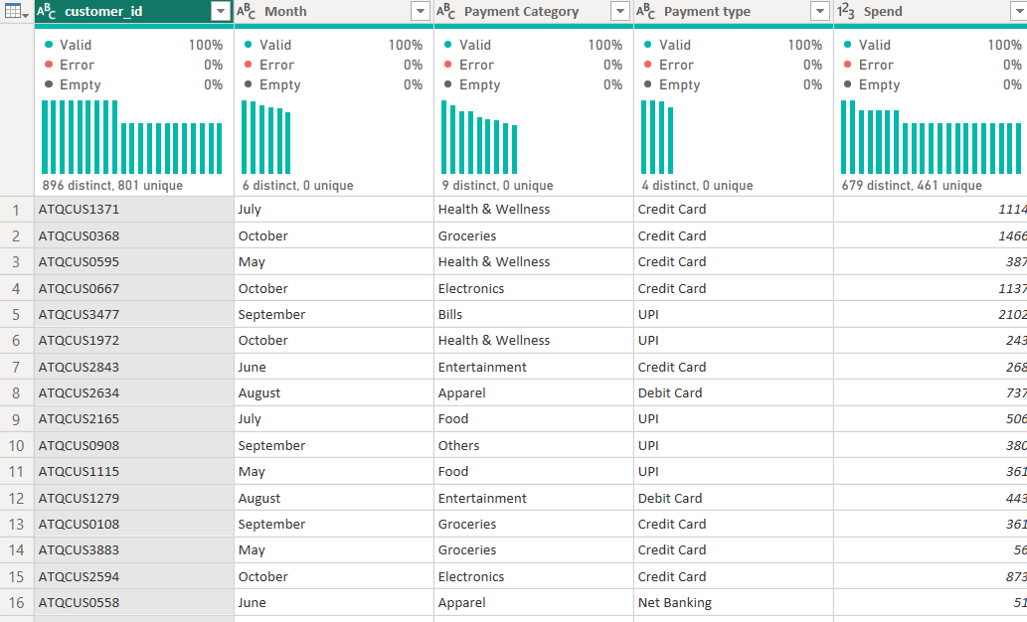
Data Layout
Column Description for fact_spends:
customer_id: This column represents the Unique ID of each customer, linking to the dim_customer table.
month: This column indicates the month in which the spending was recorded. (May, June, July, August, September, October)
category: This column describes the category of spending (Entertainment, Apparel, Electronics, etc.).
payment_type: This column specifies the type of payment used by the customer (Debit Card, Credit Card, UPI, Net Banking).
spends: This column shows the total amount spent by the customer in the specified month, category and payment_type.

Slide 5
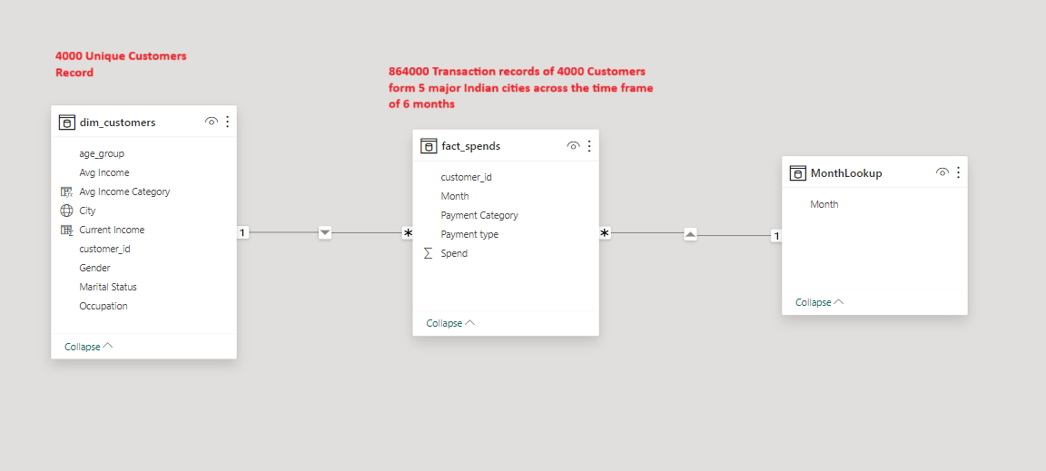
Data Model

Slide 6
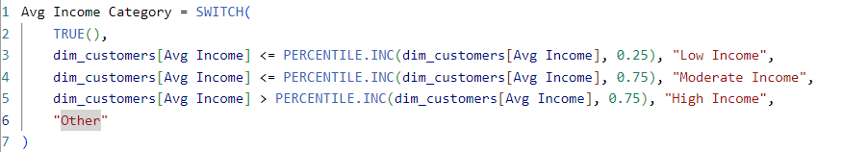
New Fields and KPI introduced
New Calculated Field
Average Income Category in dim_Customers table
Major KPI Used
Average Income Utilization %
Average Income Utilization % by Credit Card
Credit Card Adoption Rate

Slide 7
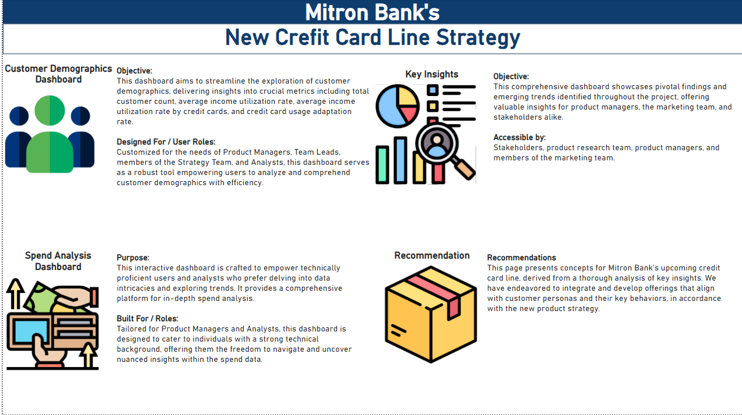
Dashboard Layout

Slide 8
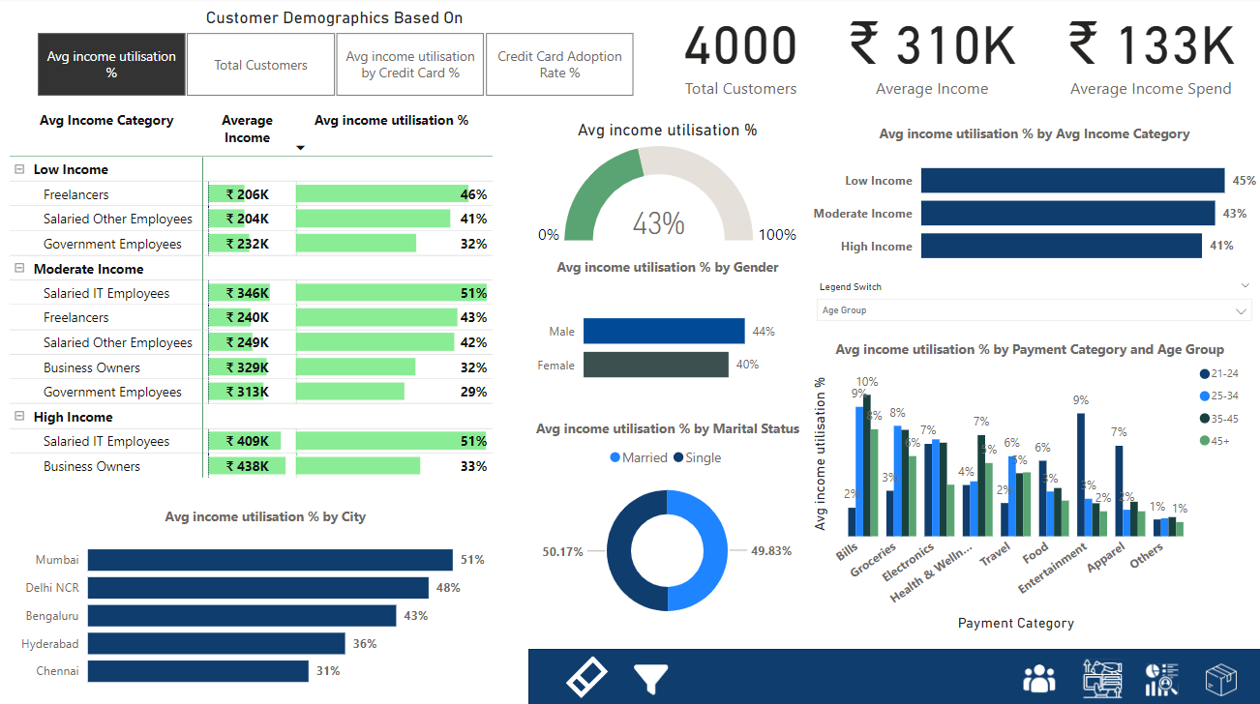
View 1 : Demographics based on Average Income utilisation

Slide 9
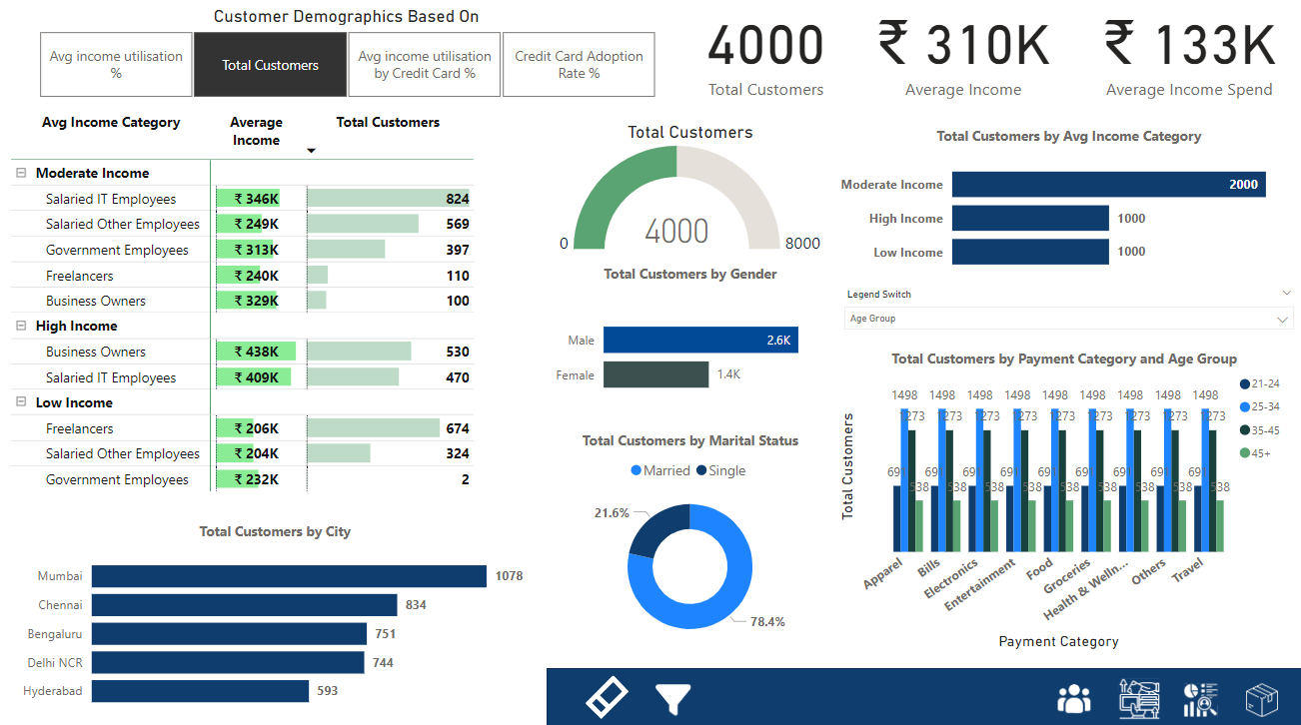
View 2 : Customer Demographics based on Total Customers

Slide 10
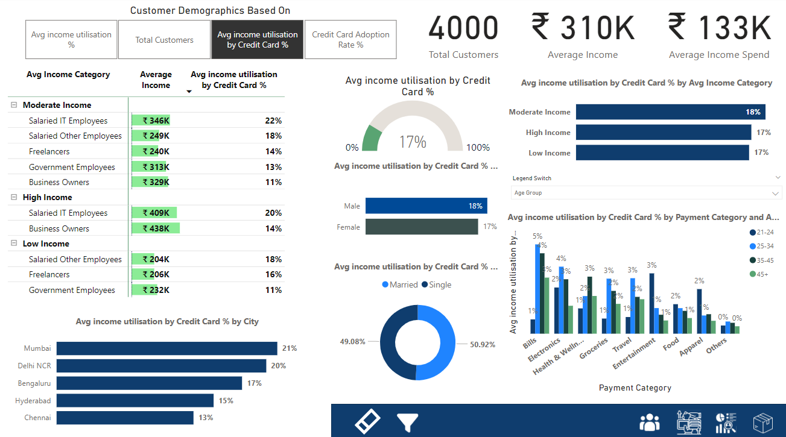
View 3 : Customer demographics based on average income utilisation by credit card

Slide 11
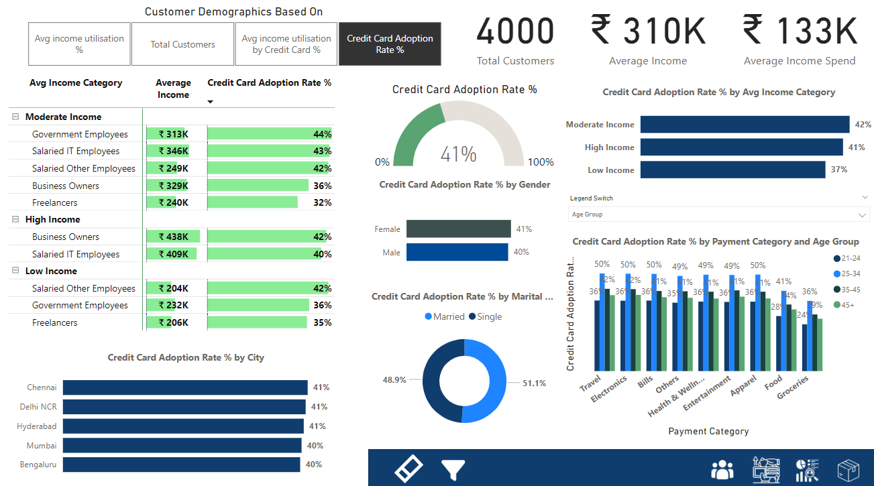
View 4 : Customer demographics based on credit card adoption rate

Slide 12
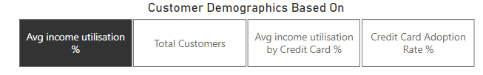
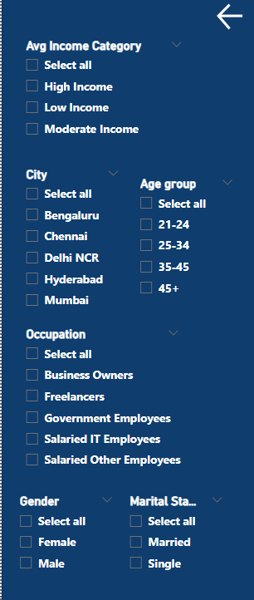
Customer demographics dashboard features / elements
Based on the requirement user can switch between different views by the use of a single click
This navigation pane contains Filter clear button (1),Filters button (2),Dashboard navigations buttons(3)
1
2
3
Once you click the filter panel button it will show you all the available filters for this dashboard

Slide 13
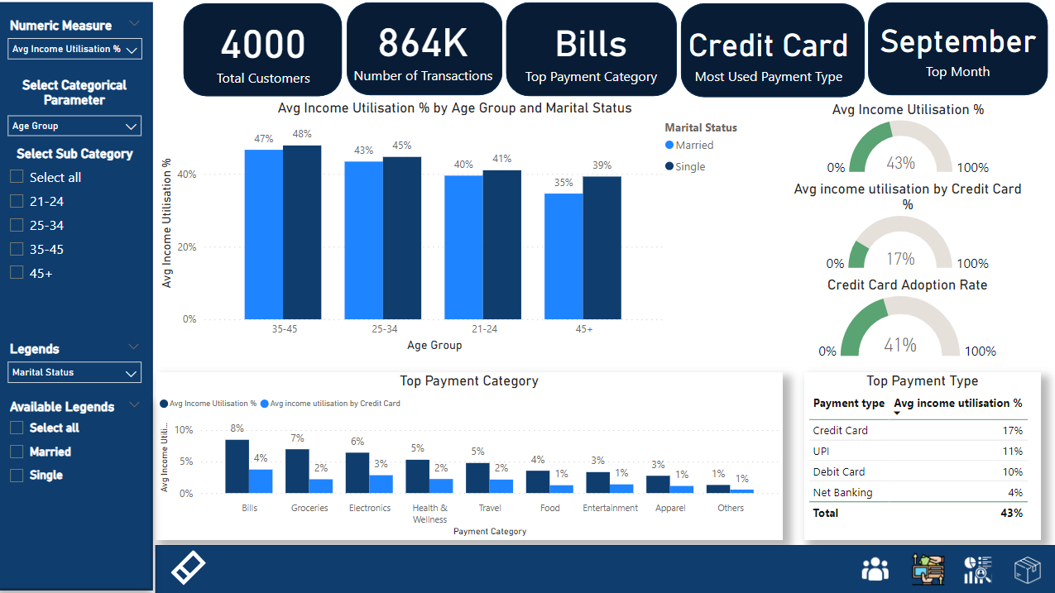
Spend Analysis Dashboard

Slide 14
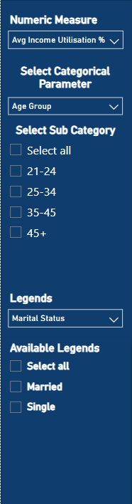
Spend Analysis Dashboard interactive elements/Slicers
Numeric Measures available options: Average Income Spend, Average Income Utilization % ,Credit Card Adoption Rate %, Number of Transactions , Total Spend (Option given to control Y access of the given Clustered Column chart of in the dashboard)
Select Categorical Parameter available options : Age Group , Average Income Category , City , Gender , Marital status , Occupation , Payment Category , Payment Type, Month(Option given to control X access of the given Clustered Column chart of in the dashboard)
Select Sub Categorical : This option is given to control what specific sub category user wants to include in the analysis
Legends: This option is provided to user to control the legends of the clustered column chart on one click (Multiselect available) you can control legends like Age Group , Average Income Category , City , Gender , Marital status , Occupation , Payment Category , Payment Type, Month
Available Legends : This option is given to control what specific Legends user want to exclude or include in there analysis

Slide 15
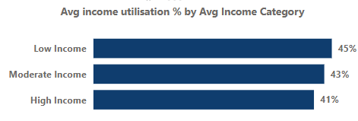
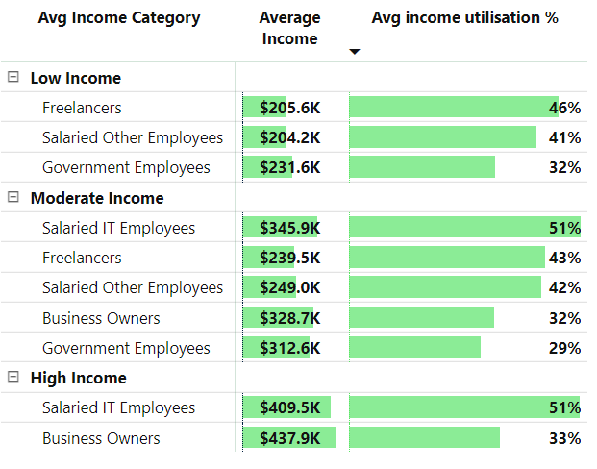
Key Insights
Highest Income utilization done by Income group
Low income group (45%)
Moderate income group (43%)
High income group (41%)
Salaried IT Employees , Salaried Other employees and Freelancers have the highest income utilization Rates
Government Employees and Business Owners have the lowest income utilization Rates

Slide 16
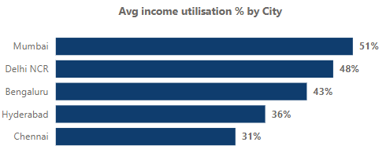
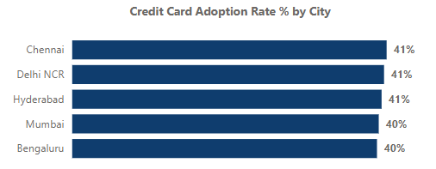
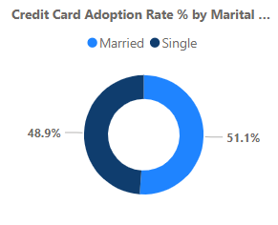
Key Insights
Mumbai leads with a 51% income utilization rate, closely followed by Delhi NCR at 48%, and Bengaluru at 43%. These cities demonstrate the highest levels of customer spending, showcasing their strong economic engagement and income utilization efficiency.
Chennai, Delhi NCR, and Hyderabad exhibit a noteworthy credit card adoption rate, with 41% of their income utilization attributed to credit card transactions. This indicates a substantial reliance on credit cards for financial transactions in these cities.
The credit card adoption rate for income utilization is notably higher among married individuals, standing at 51.1%, as opposed to the rate observed among single customers, which is recorded at 48.9%. This insight underscores a discernible disparity in credit card usage patterns based on marital status.

Slide 17
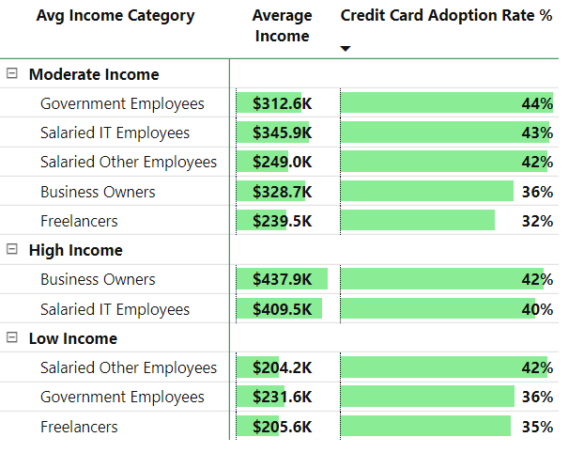
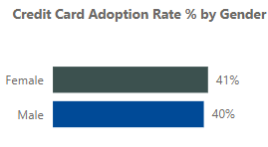
Key Insights
Credit card adoption rates demonstrate a noteworthy elevation across diverse occupational segments, with government employees exhibiting the highest adoption, followed by salaried employees and business owners. This underscores a strong proclivity within these professional cohorts for utilizing credit cards in their expenditure practices.
Female customers are more incline toward the use of Credit Cards in comparison to males

Slide 18
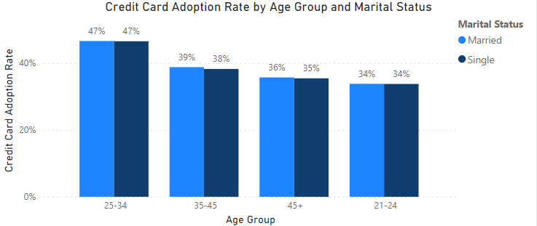
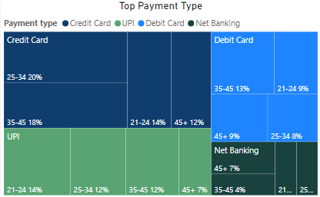
Key Insights
Analyzing the chart reveals that the highest credit card adoption rate is observed in the age group of 25-34 at 47%, closely followed by the 35-45 age group at 39%. Conversely, the lowest adoption rates are found among individuals aged 21-24 at 34%, and the 45+ age group at 36%. This indicates distinct patterns in credit card usage across various age brackets.
credit card is among the top payment among all age group but UPI is quickly gaining the market share due to ease of use and also it Is most popular among the customers of younger age group
In the upcoming slides, we will delve into an analysis of how customers across various age groups and genders allocate their income across different payment categories.

Slide 19
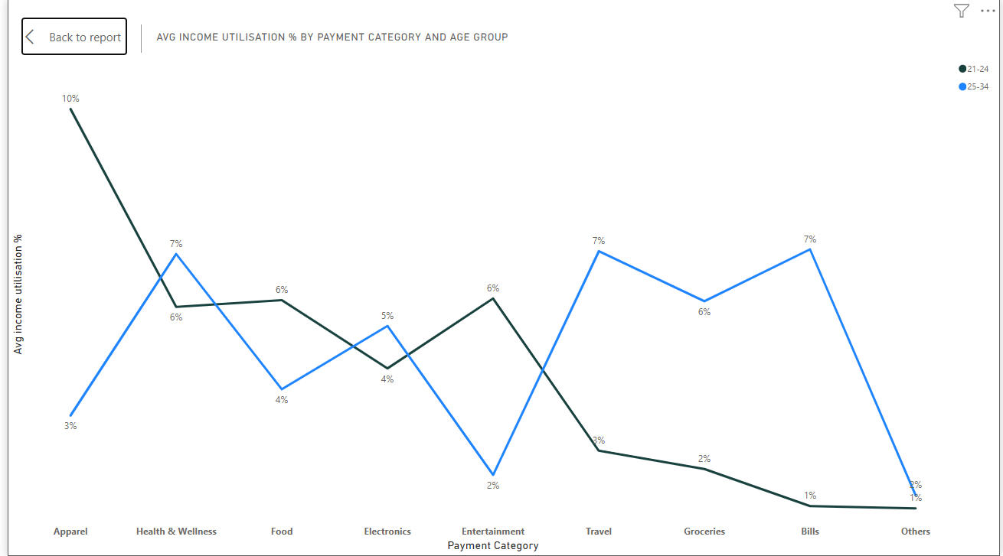
Spending Habits of Single Females
Examining the overall perspective, single females distribute a significant portion of their income across various spending categories, with a primary emphasis on Apparel (8%), Health and Wellness (6%), Food (5%), Entertainment (4%), and Travel (4%).
Upon closer examination of a younger female demographic,
particularly those within the 21-24 age range, a noticeable shift in spending preferences becomes evident. This group demonstrates an increased allocation towards Apparel (10%), Entertainment (6%), Food (6%), and Health and Wellness (6%).
As these females progress into the 25-34 age group, there is a distinct evolution in spending habits. The focus shifts towards Bills (7%), Travel (7%), Health and Wellness (7%), Groceries (6%), Electronics (5%), and Food (4%), accompanied by a slight reduction in the allocation to Apparel (3%).
This nuanced analysis highlights the dynamic nature of spending patterns among single females, emphasizing the impact of age on their financial priorities and consumption behaviors.

Slide 20
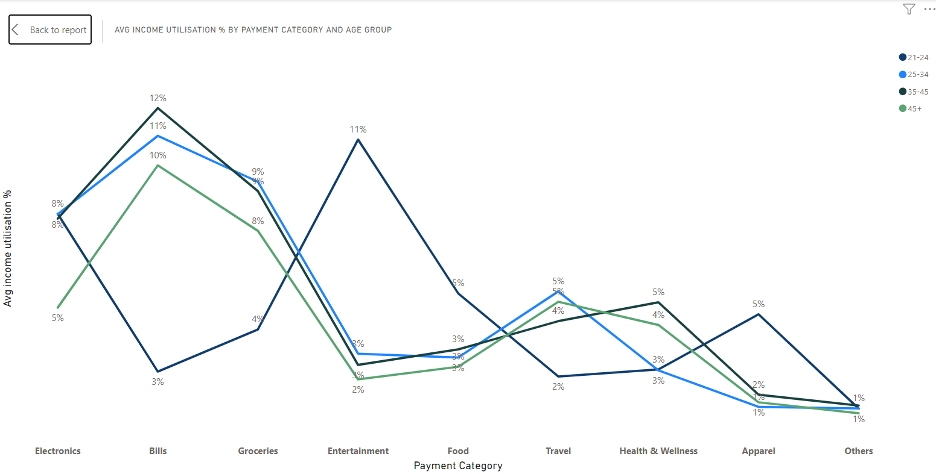
Spending Habits of Single Males
Examining the broader context, single males allocate a considerable share of their income to diverse spending categories, emphasizing Electronics (8%), Bills (6%), Groceries (6%), Entertainment (6%), Food (4%), and Travel (4%).
Upon closer inspection of spending behaviors within specific age brackets:
Younger males (21-24) display a spend allocating more towards Entertainment (11%), Electronics (8%), Food (5%), and Apparel (5%).
As the male demographic progresses into the 25-34 age group, spending preferences transition towards Bills (11%), Groceries (9%), Electronics (8%), and Travel (5%).
In the 35-45 age group, a noticeable shift occurs with increased emphasis on Bills (12%), Groceries (9%), Electronics (8%), and Health and Wellness (5%).
Males in the 45+ age group witness an evolving spending pattern, emphasizing Bills (10%), Groceries (8%), Travel (5%), Electronics (5%), and Health and Wellness (4%).
This detailed analysis unveils the dynamic nature of spending habits among single males across various life stages, providing valuable insights for strategic planning and targeted engagement.

Slide 21
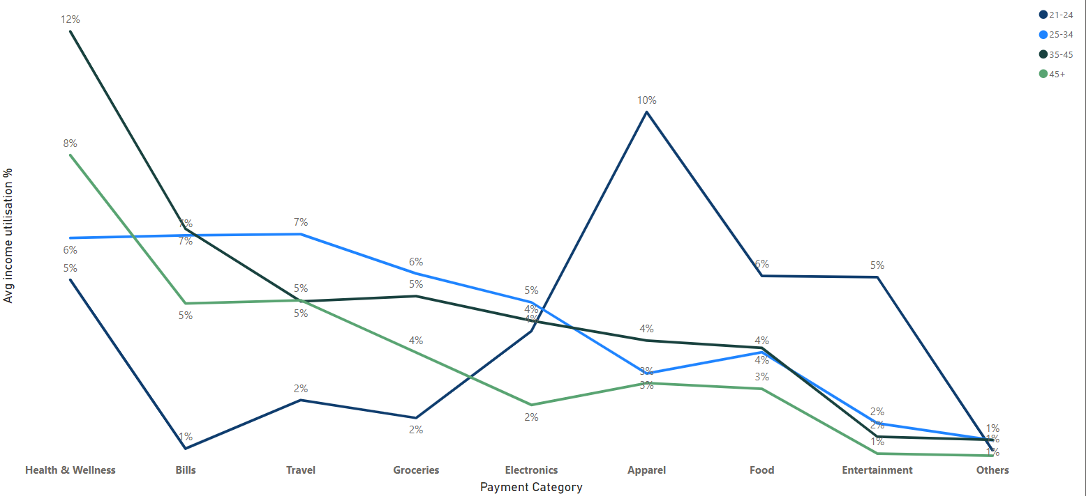
Spending Habits of Married Females
In the realm of expenditure distribution among married females, the aggregate spending pattern reveals a pronounced allocation towards Health and Wellness (9%), Bills (6%), Travel (5%), Groceries (5%), and Electronics (4%).
Upon dissecting spending behavior within specific age brackets:
Married females aged 21-24 exhibit a predominant focus on Apparel (10%), Food (6%), Entertainment (5%), and Health and Wellness (5%).
The 25-34 age group demonstrates an emphasis on Travel (7%), Bills (7%), Groceries (6%), Health and Wellness (6%), Electronics (5%), and Food (4%).
For married females aged 34-45, spending shifts towards a higher allocation for Health and Wellness (12%), Bills (7%), Groceries (5%), Electronics (4%), Food (4%), Travel (4%), and Apparel (4%).
In the 45+ age group, married females allocate a significant portion to Health and Wellness (8%), Bills (5%), Groceries (5%), Electronics (4%), and Travel (5%).
This detailed analysis provides insights into the nuanced spending behaviors of married females across different age groups, facilitating targeted strategies for product development and marketing.

Slide 22
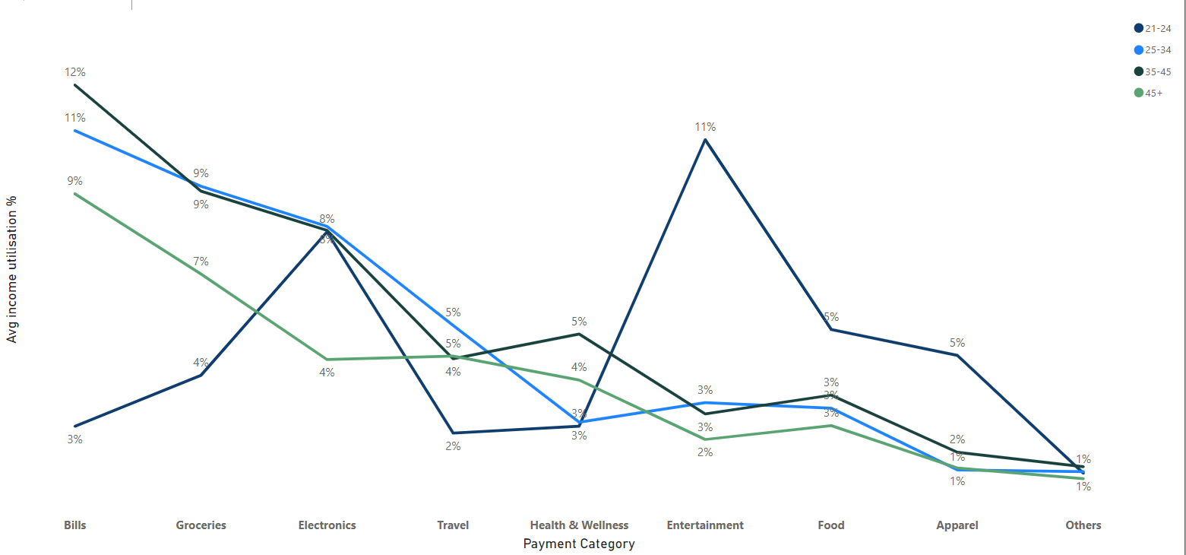
Spending Habits of Married Males
Married males strategically allocate their income across key spending categories, with significant emphasis on Bills (11%), Groceries (9%), Electronics (7%), Health and Wellness (4%), Entertainment (3%), and Food (3%).
Further delving into spending habits within distinct age groups:
Married males aged 21-24 prioritize Entertainment (11%), Electronics (8%), Food (5%), and Apparel (5%).
In the 25-34 age bracket, the focus shifts towards Bills (11%), Groceries (9%), Electronics (8%), and Travel (5%).
For the 34-45 age group, spending preferences maintain a consistency in Bills (12%), Groceries (9%), Electronics (8%), Travel (5%), and Health and Wellness (5%).
In the 45+ age category, married males allocate their budget towards Bills (9%), Groceries (7%), Travel (5%), Electronics (4%), Health and Wellness (4%), and Food (3%).
This detailed breakdown provides insights into the nuanced spending behaviors of married males across different life stages, offering valuable information for targeted financial planning and product development.

Slide 23
Product Recommendations

Slide 24
Why Age-Specific Cards Should Be The Approach
1. Targeted Marketing
Create focused campaigns for distinct age groups.
Enhance promotional effectiveness by resonating with specific audiences.
2. Customized Features
Tailor benefits to align with age-appropriate priorities.
Provide perks that cater to the unique needs of each demographic.
3. Increased Relevance
Enhance card offerings to address specific financial priorities.
Ensure relevance by aligning features with cardholders' lifestyles.
4. Customer Retention
Foster loyalty through personalized benefits.
Encourage long-term card usage by meeting evolving customer needs.
5. Risk Mitigation
Manage risk by customizing credit limits and rates.
Address potential risks associated with different customer segments.
6. Enhanced Customer Experience
Improve overall satisfaction through personalized features.
Elevate the customer experience with tailored offerings.
7. Market Differentiation
Stand out in the market with diversified credit card offerings.
Attract a broad customer base by showcasing innovation.
8. Strategic Product Development
Utilize market research for age-wise card design.
Stay competitive and responsive to evolving consumer trends

Slide 25

Presenting Our Exclusive Credit Card Collection Tailored for Every Stage of Life
Silver Spark Card (For Ages 21-24)
"Ignite Your Financial Journey with Silver Spark.“
Target Audience:
Age Group: 21-24
Marital Status: Single/Married
Minimum income 2.5LPA
Spending Habits:
Allocated spending on Apparels, Entertainment, Electronics, and Food.
Prefer UPI Transactions followed by Credit Cards.
Card Features:
Lower Interest Rates for smart financial planning.
Seamless UPI Transactions integration.
Collaborations with leading e-commerce platforms for exclusive discounts on Apparels and Electronics.
Strategic partnerships with online food delivery companies for enticing discounts, making it a preferred choice for the young and dynamic individuals.
Cashback on UPI Transactions: Earn cashback rewards for utilizing UPI transactions, encouraging digital payment habits.
Exclusive Entertainment Events Access: Attend concerts and exclusive events at discounted rates or with priority bookings.
Student Loan Integration: Collaborate with financial institutions for seamless integration with student loan repayment, providing financial flexibility.

Slide 26
Gold Horizon Card (For Ages 25-45)
"Elevate Your Finances with Gold Horizon.“
Target Audience:
Age Group: 25-45
Marital Status: Single/Married
Minimum Income 4LPA+
Spending Habits:
Focus on bills, Electronics, Groceries, Health and Wellness, Travel, Food, and Apparels.
Card Features:
Complimentary bi-yearly full health checkup, prioritizing overall well-being.
Seamless UPI Transactions integration.
Travel accidental health insurance for security during journeys.
Airport Lounge access for a touch of luxury.
Special discounts on fuel expenses.
Rewarding discounts and points on bill payments, groceries, and health-related purchases.
Personalized Financial Planning Services: Access to financial planning services for effective budget and investment management.
Eco-Friendly Spending Rewards: Encouraging eco-friendly practices by rewarding points or discounts for sustainable purchases.
Priority Customer Service: Dedicated customer service for prompt assistance, ensuring a seamless banking experience.

Slide 27
Card 3: Platinum Legacy Card (For Ages 45+)
"Crafting Your Financial Legacy with Platinum Prestige.“
Target Audience:
Age Group: 45+
Marital Status: Married/Single
Minimum Income 6LPA+
Spending Habits:
Focus on bills, Travels, Groceries, Health and Wellness, Food.
Card Features:
Complimentary quad-yearly full health checkup, emphasizing health and longevity.
Seamless UPI Transactions integration.
Travel accidental health insurance for peace of mind during travels.
Exclusive discounts on early flight bookings, making travel a seamless pleasure.
Airport Lounge access for a premium experience.
Discounts and reward points on bill payments, groceries, and health-related purchases.
Special privileges on the purchase of medicines and health supplements, catering to the unique needs of our experienced customers.
Concierge Health Services: Offering personalized health consultations and telemedicine options.
Exclusive Travel Experiences: Access curated travel experiences and packages for a hassle-free and luxurious travel experience.
Legacy Planning Services: Introduce services to assist cardholders in legacy planning, including will drafting and estate management.

